Slide 1

Container Images and their Operations
Navin Sunder – CSE21176
Richa Vivek Savant – CSE21171
Samarth Seshadri – CSE21181
Department of Computer Science & Engineering,
Amrita School of Engineering, Bengaluru

Slide 2
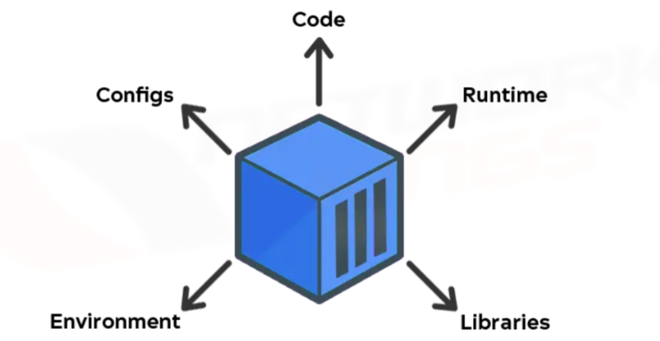
What are Container Images?
Immutable templates containing application code, runtime, libraries, and dependencies, file system snapshots & image metadata enabling deployment across diverse computing environments.
Container images become containers during runtime.
Software development has changed as a result of containerization.
Docker has become the industry standard.

Slide 3
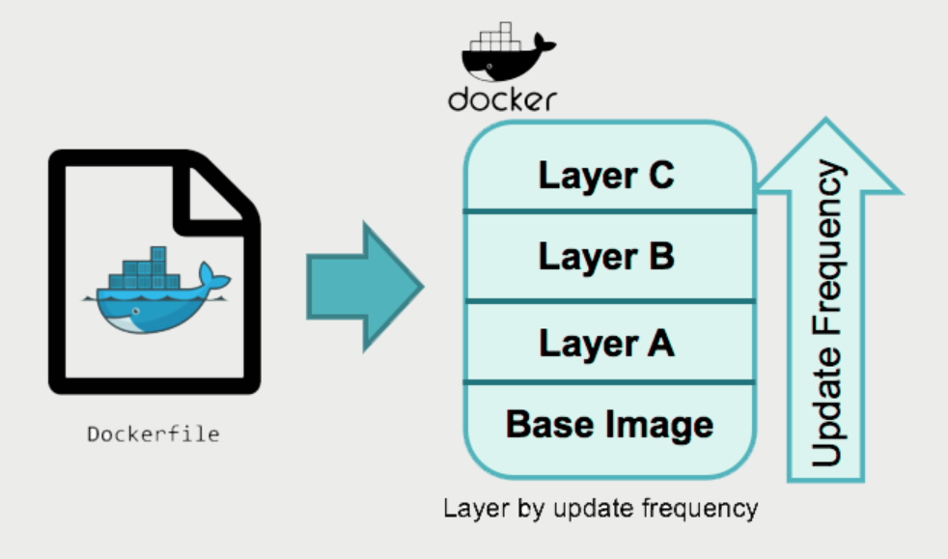
Benefits of Container Images
Efficiency - Share host OS, saving resources, unlike VMs.
Versioning & Rollback - Composed of layers.
Immutability ensures consistency, reproducibility.
Lightweight Design promotes rapid deployment, scaling.
Portability: Run containers anywhere with a Docker engine.
Scalability: Adding more containers.
Isolation: Applications run in isolation, preventing conflicts.

Slide 4
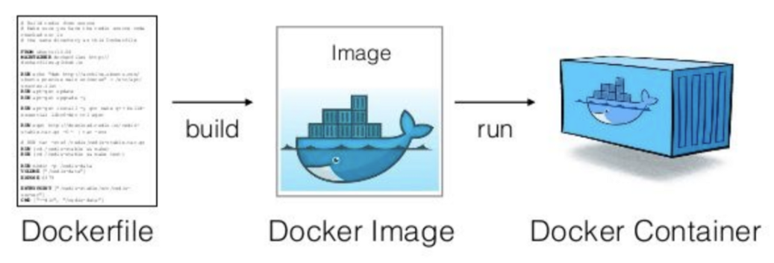
Building Container Images: Dockerfile
Dockerfile - A text file containing instructions for building images. Instructions include FROM, COPY, CMD, etc.
They are either built from a parent image or an empty pseudo image called “scratch”.

Slide 5
Building and Running Container Images: Dockerfile
Building the container image from the created Dockerfile
-> docker build -t <img_name> .
Listing the container image
-> docker images
-docker run command to execute container images
-> docker run -t -p 80:80 <img_name>
Access the web server in your browser at http://localhost

Slide 6
Inspecting Running Containers
Use docker ps to list running containers
Get detailed information with docker inspect container_id
View logs with docker logs container_id

Slide 7
Stopping and removing Containers
Stop a running container with docker stop container_id
Remove a stopped container with docker rm container_id
Use docker rm -f to forcefully remove a container

Slide 8
PRACTICAL IMPLEMENTATION

Slide 9
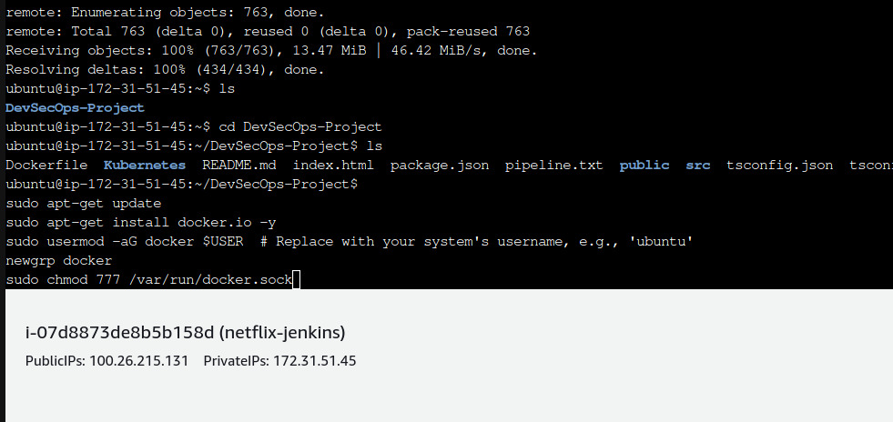
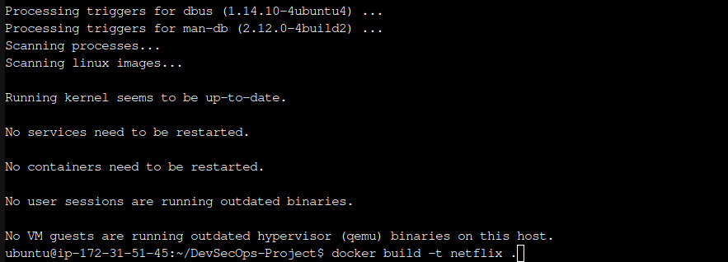

Slide 10
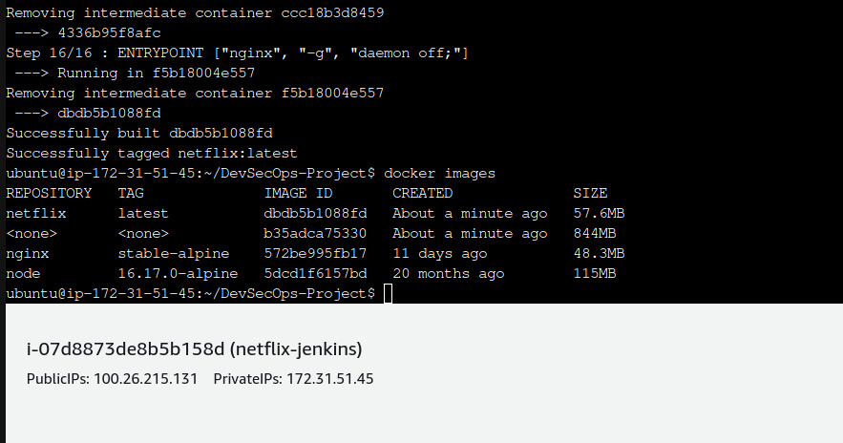

Slide 11
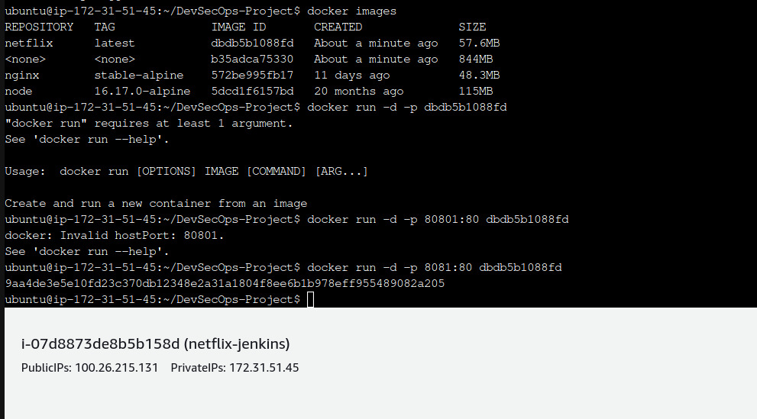

Slide 12


Slide 13
Conclusion
Docker containers provide a lightweight and portable way to package applications
Building container images with Dockerfiles offers a standardized approach
Running containers from images and performing basic operations empowers efficient application management

Slide 14

Thank you !!!!!

